Slide 1
Introduction to Data Science
John P Dickerson
Lecture #27 – 12/03/2020
Lecture #28 – 12/08/2020
CMSC320
Tuesdays & Thursdays
5:00pm – 6:15pm (… or anytime on the Internet)

Slide 2
Announcements
Project #3 is due tonight:
See Piazza pinned post for update on grading
TAs will be active on Piazza through tonight
Project #4 is posted:
It involves an interactive visualization; you’ll have to open the .html file in a browser
Live code is here, too: https://colab.research.google.com/drive/1JEJJQ74bSiG9RPbdGDMjUWhHlI98Om6E?usp=sharing
Shouldn’t take too long, hopefully fun!

Slide 3
Today’s Lecture
Data collection
Data processing
Exploratory analysis
&
Data viz
Analysis, hypothesis testing, & ML
Insight & Policy Decision
BIG THANKS: Zico Kolter (CMU)
& Amol Deshpande (UMD)

Slide 4
Statistical Inference
Statistical inference is the discipline that concerns itself with the development of procedures, methods, and theorems that allow us to extract meaning and information from data that has been generated by stochastic (random) processes.
Process of going from the world to the data, and then back to the world
Often the goal is to develop a statistical model of the world from observed data
Conclusion is typically:
an estimate;
or a confidence interval;
or rejection of a hypothesis
or clustering or classification of data points into groups

Slide 5
Basic Probability I
Probability is concerned with the outcome of a trial (also called experiment or observation)
Sample Space: Set of all possible outcomes of a trial
Probability of Sample Space = 1
Event is the specification of the outcome of a trial
For example: Trial = Tossing a coin; Sample Space = {Heads, Tails}; Event = Heads
If two events E and F are independent, then: Probability of E does not change if F has already happened = P(E), i.e., P(E | F) = P(E)
Also: P(E AND F) = P(E) * P(F)
If two events E and F are mutually exclusive, then: P(E UNION F) = P(E) + P(F)

Slide 6
Basic Probability II
Bayes Theorem P(A | B) = P(B | A) * P(A) / P(B)
Simple equation, but fundamental to Bayesian inference
Conditional Independence: A and B are conditionally independent given C if: Pr(A AND B | C) = Pr(A | C) * Pr(B | C)
Powerful in reducing the computational efforts in storing and manipulating large joint probability distributions
Entropy: A measure of the uncertainty in a probability distribution
Wikipedia Article

Slide 7
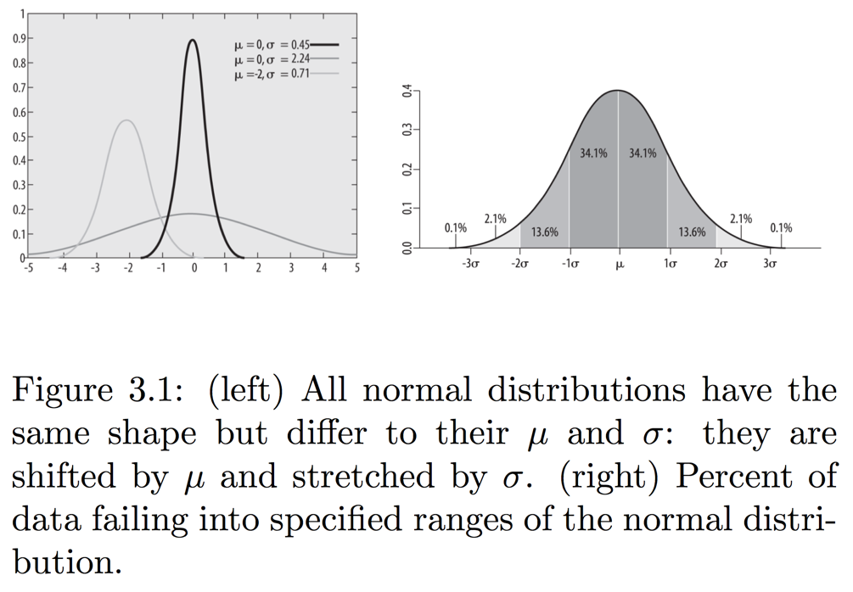
RecaLl: Normal Distribution
99.7% values will fall within 3 standard deviations (around the mean)
95% for 2 standard deviations; 68% for 1
Central Limit Theorem: As sample size approaches infinity, distribution of sample means will follow a normal distribution irrespective of the original distribution

Slide 8
Hypothesis Testing
Accepting or rejecting a statistical hypothesis about a population
H_0: null hypothesis, and H_1: the alternative hypothesis
Mutually exclusive and exhaustive
H_0 can never be proven to be true, but can be rejected
Sometimes don’t have H_1 at all (Fisher’s test)
Statistical significance: probability that the result is not due to chance
Example: Deciding if a coin is fair
http://20bits.com/article/hypothesis-testing-the-basics

Slide 9
Hypothesis Testing
H₀: null hypothesis, and H₁: the alternative hypothesis
Mutually exclusive and exhaustive
H₀ can never be proven to be true
Statistical significance: probability that the result is not due to chance
Process:
Decide on H₀ and H₁
Decide which test statistic is appropriate
Roughly, how well does my sample agree with the null hypothesis?
Key question: what is the distribution of the test statistic over samples?
Select a significance level (sigma), a probability threshold below which the null hypothesis will be rejected -- typically 5% or 1%.
Compute the observed value of the test statistic t_{obs} from the sample
Compute p-value: the probability that the test statistic took that value by chance
Use the distribution above to compute the p-value
Reject the null hypothesis if the p-value < \sigma

Slide 10
Summary
Hypothesis testing allows us to formulate beliefs about investment attributes and subject those beliefs to rigorous testing following the scientific method.
For parametric hypothesis testing, we formulate our beliefs (hypotheses), collect data, and calculate a value of the investment attribute in which we are interested (the test statistic) for that set of data (the sample), and then we compare that with a value determined under assumptions that describe the underlying population (the critical value). We can then assess the likelihood that our beliefs are true given the relationship between the test statistic and the critical value.
Commonly tested beliefs associated with the expected return and variance of returns for a given investment or investments can be formulated in this way.

Slide 15
Notes:
Var(X) = E[ (X-mu)^2 ]

Slide 16
Notes:
The degrees of freedom (DF) are the amount of information your data provide that you can "spend" to estimate the values of unknown population parameters, and calculate the variability of these estimates. This value is determined by the number of observations in your sample. Increasing your sample size provides more information about the population, and thus increases the degrees of freedom in your data.
The 1-sample t-test estimates only one parameter: the population mean.
The sample size of n constitutes n pieces of information for estimating the population mean and its variability. One degree of freedom is spent estimating the mean, and the remaining n-1 degrees of freedom estimate variability. Therefore, a 1-sample t-test uses a t-distribution with n-1 degrees of freedom
Source: Minitab

Slide 19
Notes:
Null hypothesis tests validity of a claim about a population (e.g., “men and women do not score differently on CMSC320 exams.”)
Alternative hypothesis: men and women score differently / women score higher / women do not score higher (two-sided vs one-sided)
Tp

Slide 20
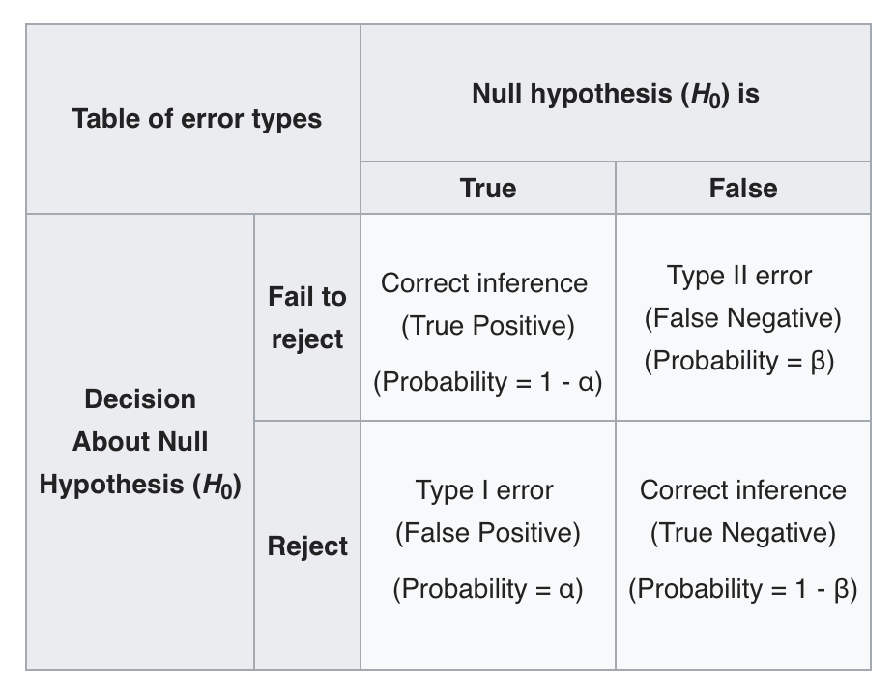
Source: Wikipedia

Slide 31
Scientific method: Statistical Errors
Nature Article
P values not as reliable as many scientists assume
p-hacking: cherry picking data points etc., to get the p-values; repeating experiments if they fail till you get the result
Much discussion/debate about this issue in recent years

Slide 32
Sampling Biases
Sampling effective at reducing the data you need to analyze
Ideally you want random sample
Otherwise you need to account for bias, which can be tricky
Bias in sampling: need to be very careful when generalizing inferences drawn from a sample
Even for random samples
Questions to ask: How was the sample selected? Was it truly random? Potential biases? How were questions worded? How is missing data/attrition handled? Was the sample size large enough?

Slide 33
Some Potential Sources of Biases
Sample Bias
Selection bias: some subjects more likely to be selected
Volunteer bias: people who volunteer are not representative
Nonresponse bias: people who decline to be interviewed
Survey/Response Bias
Interviewer bias
Acquiescence bias – tendency to agree with all questions
Social desirability bias: people are not going to admit to embarrassing things
Also watch out for:
Confirmation bias
Anchor bias

Slide 34
Some Potential Sources of Biases
Gold Standard: Randomized Clinical Trials
Some people receive "treatment", others in a "control" group
Picked randomly to take care of all confounding factors
Problems:
Ethically feasible only if clinically equipoise
Can't ask some people to smoke to figure out the effects of smoking
Very expensive and cumbersome
Impossible in many cases
E.g.: Recent Facebook experiment on emotions
A true state of equipoise exists when one has no good basis for a choice between two or more care options. - NIH

Slide 35
Determining Causation
Bradford Hill’s Criteria: widely accepted in the modern era as useful guidelines for investigating causality in epidemiological studies
Strength: how large is the association
Consistency across different samples
How specific
Cause should precede effect (temporality)
Biological gradient (increase dose → increase association)
Plausibility
Coherence
Experiment
Consideration of alternate explanations

Slide 36
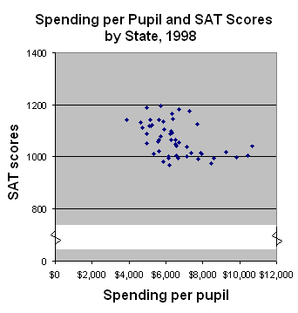
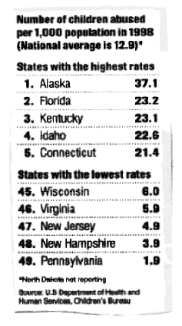
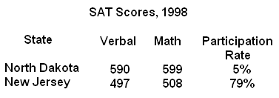
Misuse of Statistics
This famous, but old book on statistics goes into detail about How to lie with statistics

Slide 37
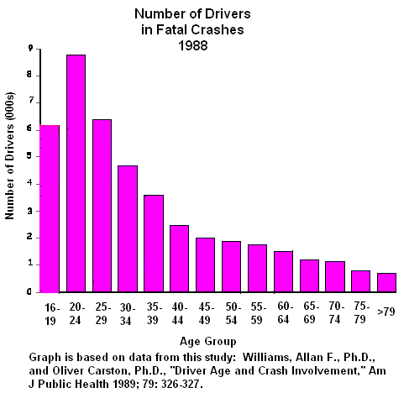
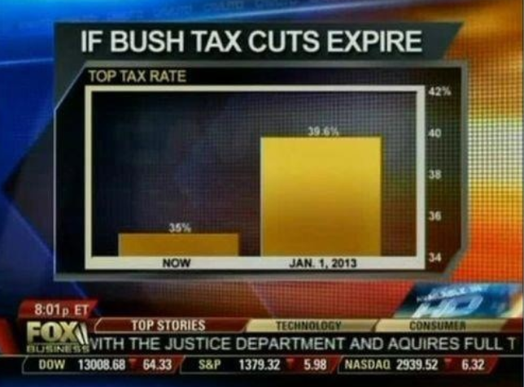
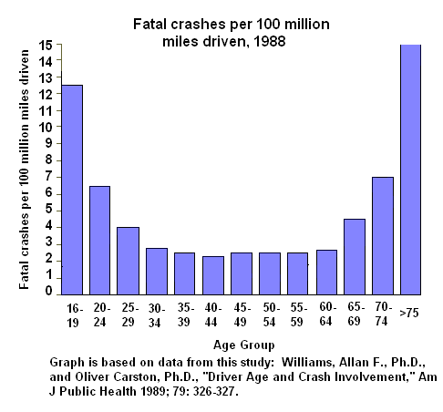
Beware of Charts !

Slide 38
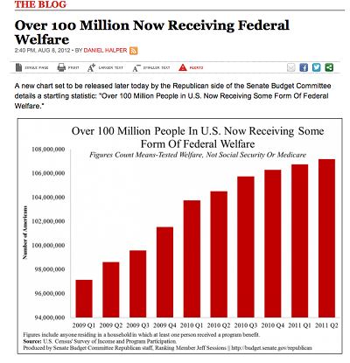
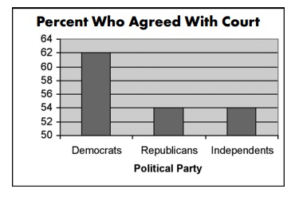
Beware of Charts !
Terry Schiavo Case

Slide 39
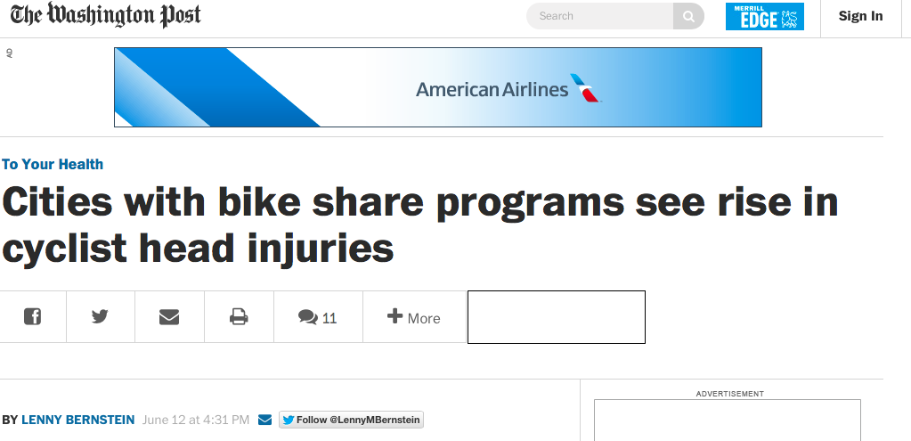
Newspapers even more
Source
A Washington Post article says: In the first study of its kind, researchers from Washington State University and elsewhere found a 14 percent greater risk of head injuries to cyclists associated with cities that have bike share programs. In fact, when they compared raw head injury data for cyclists in five cities before and after they added bike share programs, the researchers found a 7.8 percent increase in the number of head injuries to cyclists.
Actually: head injuries declined from 319 to 273, and overall injuries declined from 757 to 545
So the proportion of head injuries went up !!

Slide 40
Next up
Data collection
Data processing
Exploratory analysis
&
Data viz
Analysis, hypothesis testing, & ML
Insight & Policy Decision
BIG THANKS: Zico Kolter (CMU)
& Amol Deshpande (UMD)

Slide 41
Outline
Informed Consent
Reproducibility
p-value Hacking
Who owns the data?
Privacy & Anonymity
Debugging Data Science
Algorithmic fairness
Data validity/provenance

Slide 42
Informed Consent
Respect for persons -- cornerstone value for any conception of research ethics
Informed consent de facto way to “operationalize” that principle
Integral component of medical research for many decades
Applicable for any research where “personal information” is divulged or human experimentation performed
Institutional Review Boards (IRBs) in charge of implementing
How it translates into the “big data” world?
Largely ignored by most researchers
Notes:
Informed consent has been challenged—if not outright undermined—by research activities enabled by increasingly advanced networked information and communication technologies (ICTs) and the massive quantities of social and individually identifiable data they can produce. The rise of “big data” has raised new and compounded existing questions around the ethical treatment of human subjects in research, as legacy models forged in medical and behavioral research contexts are not easily applied to data scientific practice
many researchers and private companies have ignored or outright abandoned core research ethics ideas like “informed consent” as untenable, relying instead on notice and consent practices which do not share the same grounding in research ethics or even moral theory generally. This results in often opaque or impenetrable privacy policies and data use notices or—worse—no notice at all.

Slide 43
History
Systematic scientific experimentation on human subjects rare and isolated prior to the late 19th century
Some early directives in late 19th century and early 20th century
Prussian directive in 1900: any medical intervention for any purpose other than diagnosis, healing, and immunisation must obtain “unambiguous consent” from patients after “proper explanation of the possible negative consequences” of the intervention
Nuremberg Code, drafted after conclusion of Nazi Doctors’ trials:
established a universal ethical framework for clinical research
“the voluntary consent of the human subject is absolutely essential” to ethical research
Detailed specific guidelines on what to present to subjects (nature/duration/purpose, how conducted, effects on health, etc)
Notes:
Early medical efforts were mostly therapeutic and intended to directly benefit an individual
moral and ethical frameworks governing the actions of doctors (like the Hippocratic Oath) did not address experimentation
In 1891, for example, a Prussian minister released a directive that tuberculin should not be administered as treatment for tuberculosis “against the patient’s will”
In 1898, for example, the German physician Albert Neisser began injecting sex workers with serum from syphilis patients as an experimental method for prevention—albeit without their consent
, the Nuremberg Code breaks somewhat with the earlier German guidelines, as it emphasizes voluntariness over informedness—the first principle of voluntary consent prescribes. Despite the prioritization of voluntariness, the code does note that consent should entail “sufficient knowledge and comprehension of the elements of the subject matter involved, as to enable [the subject] to make an understanding and enlightened decision”. detail specific kinds of information that should be presented during the consenting process: “the nature, duration, and purpose of the experiment; the method and means by which it is to be conducted; all inconveniences and hazards reasonably to be expected; and the effects upon his health or person, which may possibly come from his participation in the experiment”

Slide 44
History
Salgo v Leland Stanford etc. Board of Trustees (1957) … cited as establishing the legal doctrine of informed consent for medical practice and biomedical research in the United States
plaintiff was awarded damages for not receiving full disclosure of facts
In 1953: NIH put the first IRB in place in its own hospital
… voluntary agreement based on informed understanding shall be obtained from the patient
… will be given an oral explanation in terms suited for his comprehension
Only required a voluntary signed statement if the procedure involved “unusual hazard.”
Notes:
Surgery that went very wrong, wasn’t given full risk info

Slide 45
History
A more detailed list of requirements emerged later
1) A fair explanation of the procedures to be followed, including an identification of those which are experimental;
2) A description of the attendant discomforts and risks;
3) A description of the benefits to be expected;
4) A disclosure of appropriate alternative procedures that would be advantageous for the subject;
5) An offer to answer any inquires concerning the procedures;
6) An instruction that the subject is free to withdraw his consent and to discontinue participation in the project or activity at any time
“Common Rule” – codification of “respect for persons, beneficence, and justice”
Regulates use of human subjects in US today
More elaborate treatment of all of these aspects

Slide 46
Non-medical research
Unclear how the rules translate to other types of research
Identifying harm or potential risks difficult
Requirements and experiments change over the course of the study
The list of subjects itself evolving
CS has rarely had to deal with IRBs
Although changing…
Notes:
Data analyses, in particular, “rarely appear as a direct ‘intervention’ in the life or body of an individual human being” (

Slide 47
Industry research
Less distinction between conventional or academic social scientific research and industry- or market-oriented research
Data fusion can lead to new insights and uses of data
Hard to translate the “informed consent” requirements to these settings

Slide 48
Case study: facebook emotional experiment
Facebook routinely does A/B testing to test out new features (e.g., layouts, features, fonts, etc)
In 2014: intentionally manipulated news feeds of 700k users
Changed the number of positive and negative stories the users saw
Measured how the users themselves posted after that
Hypothesis: Emotions spread over the social media
Huge outcry
Facebook claims it gets the “consent” from the user agreement
Notes:
In an academic paper published in conjunction with two university researchers, the company reported that, for one week in January 2012, it had altered the number of positive and negative posts in the news feeds of 689,003 randomly selected users to see what effect the changes had on the tone of the posts the recipients then wrote.
The researchers found that moods were contagious. The people who saw more positive posts responded by writing more positive posts. Similarly, seeing more negative content prompted the viewers to be more negative in their own posts.
Although academic protocols generally call for getting people’s consent before psychological research is conducted on them, Facebook didn’t ask for explicit permission from those it selected for the experiment. It argued that its 1.28 billion monthly users gave blanket consent to the company’s research as a condition of using the service.
Mr. Kramer wrote that changing the emotional makeup of the news feeds had a minimal impact, prompting users to produce an average of one fewer emotional word per thousand words over the following week.
When someone logs in, there are typically about 1,500 items the company could display in that person’s news feed, but the service shows only about 300 of them.
What you see is chosen by a mysterious algorithm that takes into account hundreds of factors, such as how often you comment on your Aunt Sally’s photos, how much your friends are talking about a colleague’s post about her new job, and whether you always watch those cat videos.

Slide 49
Okcupid experiments
Experiment 1: Love is Blind
Turned off photos for a day
Activity went way down, but deeper conversations, better responses
Deeper analysis at the link below
Experiment 2:
Turned off text or not – kept picture
Strong support for the hypothesis that the words don’t matter
Experiment 3: Power of Suggestion
Told people opposite of what the algorithm suggested
https://theblog.okcupid.com/we-experiment-on-human-beings-5dd9fe280cd5

Slide 50
GDPR and Consent
General Data Protection Regulation – new law in EU that recently went into play
Requires unambiguous consent
data subjects are provided with a clear explanation of the processing to which they are consenting
the consent mechanism is genuinely of a voluntary and "opt-in" nature
data subjects are permitted to withdraw their consent easily
the organisation does not rely on silence or inactivity to collect consent (e.g., pre‑ticked boxes do not constitute valid consent);

Slide 51
Outline
Informed Consent
Reproducibility
p-value Hacking
Who owns the data?
Privacy & Anonymity
Debugging Data Science
Algorithmic fairness
Data validity/provenance

Slide 52
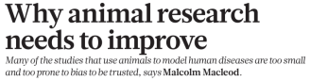
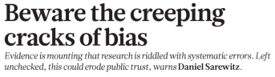
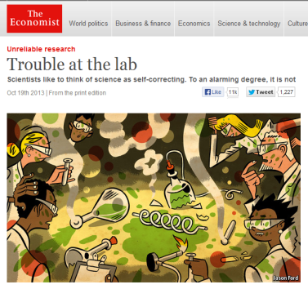
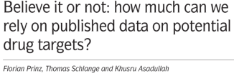
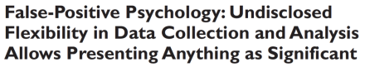

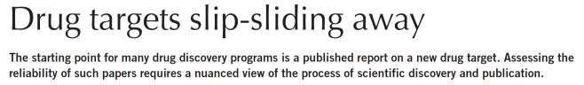
The Reproducibility Challenge
Noted by research community; in multiple publications
Across research areas
Especially in preclinical research

Slide 53
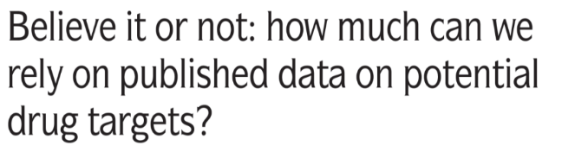
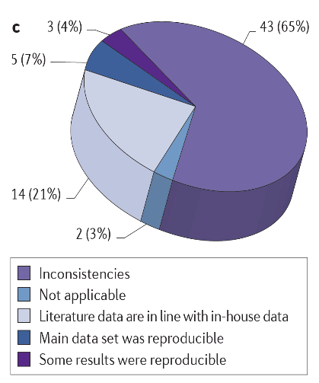
Prinz, Schlange and Asadullah
Bayer HealthCare
Nature Reviews Drug Discovery
2011; 10:712-713
Notes:
http://www.nature.com/nrd/journal/v10/n9/full/nrd3439-c1.html

Slide 54
Notes:
NINDS Workshop: http://www.ninds.nih.gov/funding/areas/channels_synapses_and_circuits/rigor_and_transparency/index.htm
Landis et al article: http://www.nature.com/nature/journal/v490/n7419/full/nature11556.html

Slide 55
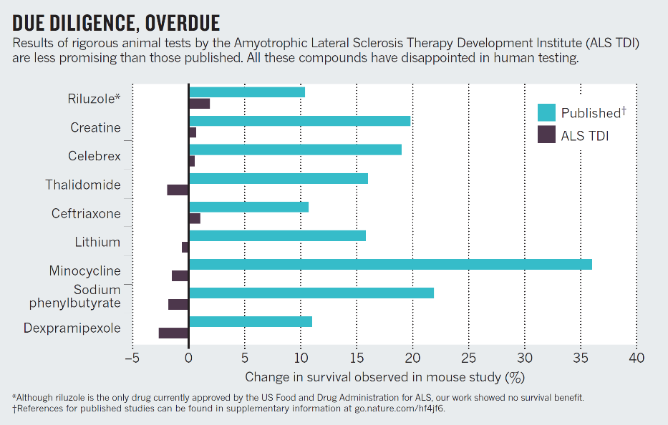
Perrin, Nature 2014; 507: 423-4255
Notes:
http://www.nature.com/news/preclinical-research-make-mouse-studies-work-1.14913

Slide 56
Challenges to Rigor and Transparency in Reporting Science
Science often viewed as self-correcting
Immune from reproducibility problems?
Principle remains true over the long-term
In the short- and medium-term, interrelated factors can short-circuit self-correction
Leads to reproducibility problem
Loss of time, money, careers, public confidence

Slide 57

Factors that “Short Circuit” Self-Correction
Current “hyper-competitive” environment fueled, in part, by:
Historically low funding rates
Grant review and promotion decisions depend too much on “high profile” publications
$$
Notes:
Current “hyper-competitive” environment fueled, in part, by:
Historically low funding rates
Over-dependence on “high profile” publications when grants are reviewed; institutions are making appointment, promotion, and tenure decisions

Slide 58

Factors that “Short Circuit” Self-Correction
Publication practices:
Difficulty in publishing negative findings
Overemphasis on the “exciting, big picture” finding sometimes results in publications leaving out necessary details of experiments
Notes:
Image by Sławek Borewicz (Own work) [CC BY-SA 3.0 (http://creativecommons.org/licenses/by-sa/3.0)], via Wikimedia Commons

Slide 59
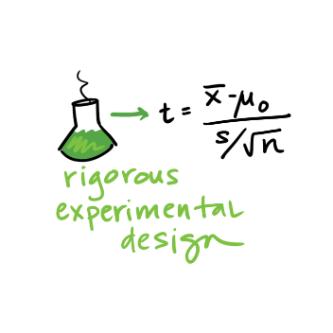
Factors that “Short Circuit” Self-Correction
Poor training
Inadequate experimental design
Inappropriate use of statistics (“p-hacking”)
Incomplete reporting of resources used and/or unexpected variability in resources
Notes:
Poor training
Inadequate experimental design – fundamental quality characteristics not reported/performed (e.g. blinded assessment, randomization, sample size calculations)
Inappropriate use of statistics (“p-hacking”)
Incomplete reporting of resources used and/or unexpected variability in resources

Slide 60
Reproducibility
Extremely important aspect of data analysis
“Starting from the same raw data, can we reproduce your analysis and obtain the same results?”
Using libraries helps:
Since you don’t reimplement everything, reduce programmer error
Large user bases serve as “watchdog” for quality and correctness
Standard practices help:
Version control: git, git, git, …, git, svn, cvs, hg, Dropbox
Unit testing: unittest (Python), RUnit (R), testthat
Share and publish: github, gitlab
Slides adapted from Hector Corrado Bravo

Slide 61
Practical Tips
Many tasks can be organized in modular manner:
Data acquisition:
Get data, put it in usable format (many ‘join’ operations), clean it up – Anaconda lab from Tuesday!
Algorithm/tool development:
If new analysis tools are required
Computational analysis:
Use tools to analyze data
Communication of results:
Prepare summaries of experimental results, plots, publication, upload processed data to repositories
Usually a single language or tool does not handle all of these equally well – choose the best tool for the job!

Slide 62
Practical Tips
Modularity requires organization and careful thought
In Data Science, we wear two hats:
Algorithm/tool developer
Experimentalist: we don’t get trained to think this way enough!
It helps two consciously separate these two jobs

Slide 63
Think like an experimentalist
Plan your experiment
Gather your raw data
Gather your tools
Execute experiment
Analyze
Communicate

Slide 64
Think like an experimentalist
Let this guide your organization. One potential structure for organizing a project:
project/
| data/
| | processing_scripts
| | raw/
| | proc/
| tools/
| | src/
| | bin/
| exps
| | pipeline_scripts
| | results/
| | analysis_scripts
| | figures/

Slide 65
Think like an experimentalist
Keep a lab notebook!
Literate programming tools are making this easier for computational projects:
http://en.wikipedia.org/wiki/Literate_programming (Lec #2!)
https://ipython.org/
http://rmarkdown.rstudio.com/
http://jupyter.org/

Slide 66
Think like an experimentalist
Separate experiment from analysis from communication
Store results of computations, write separate scripts to analyze results and make plots/tables
Aim for reproducibility
There are serious consequences for not being careful
Publication retraction
Worse: http://videolectures.net/cancerbioinformatics2010_baggerly_irrh/
Lots of tools available to help, use them! Be proactive: learn about them on your own!

Slide 67
Outline
Informed Consent
Reproducibility
p-value Hacking
Who owns the data?
Privacy & Anonymity
Debugging Data Science
Algorithmic fairness
Data validity/provenance

Slide 68
American Statistical Association Statement on p-Values
Q:Why do so many colleges and grad schools teach p =0.05?
A: Because that’s still what the scientific community and journal editors use.
Q:Why do so many people still use p = 0.05?
A:Because that’s what they were taught in college or grad school.
ASA statement
- George Cobb, Professor Emeritus of Mathematics and Statistics - Mt Holyhoke College

Slide 69
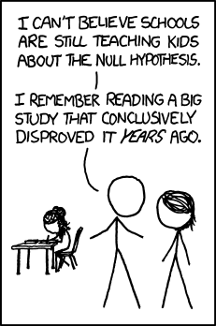
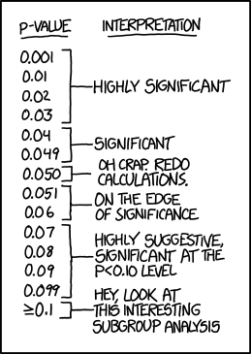
What is a p-value?

Slide 70
Misconceptions about the p-value
The p-value is not the probability that the null hypothesis is true or the probability that the alternative hypothesis is false. It is not connected to either.
The p-value is not the probability that a finding is "merely a fluke."
The p-value is not the probability of falsely rejecting the null hypothesis.
The p-value is not the probability that replicating the experiment would yield the same conclusion.
The significance level, such as 0.05, is not determined by the p-value.
The p-value does not indicate the size or importance of the observed effect.
Misconceptions about p-value has its own Wikipedia page

Slide 71
What is a p-value?
Informally, a p-value is the probability under a specified statistical model that a statistical summary of the data (e.g., the sample mean difference between two compared groups) would be equal to or more extreme than its observed value.

Slide 72
Principle 1
P-values can indicate how incompatible the data are with a specified statistical model.
The smaller the p-value, the greater the statistical incompatibility of the data with the null hypothesis, if the underlying assumptions used to calculate the p-value hold.
This incompatibility can be interpreted as casting doubt on or providing evidence against the null hypothesis or the underlying assumptions.

Slide 73
Principle 2
P-values do not measure the probability that the studied hypothesis is true, or the probability that the data were produced by random chance alone.
The p-value is a statement about data in relation to a specified hypothetical explanation, and is not a statement about the explanation itself.

Slide 74
Principle 2 – Don’t flip the conditionality
p-value is not P(Ho is true | getting data this extreme)
p-value is P(getting data this extreme | Ho is true)

Slide 75
Illustrative Example (Bayesian)
Suppose there is a 5% probability that a research hypothesis (Ha) is true (prior).
You conduct the test with 90% power.
The p-value of the test is 0.04
Using Bayes’ Rule:

Slide 76
Principle 3
Scientific conclusions and business or policy decisions should not be based only on whether a p-value passes a specific threshold
A conclusion does not immediately become “true” on one side of the divide and “false” on the other.
Researchers should bring many contextual factors into play to derive scientific inferences, including the design of a study, the quality of the measurements, the external evidence for the phenomenon under study, and the validity of assumptions that underlie the data analysis.

Slide 77
Principle 4
Proper inference requires full reporting and transparency
p-values and related analyses should not be reported selectively.
Cherry picking promising findings, also known by such terms as data dredging, significance chasing, significance questing, selective inference, and “p-hacking,” leads to a spurious excess of statistically significant results in the published literature and should be vigorously avoided.
Example of p-hacking (from xkcd)

Slide 78
Principle 5
A p-value, or statistical significance, does not measure the size of an effect or the importance of a result.
Statistical significance is not equivalent to scientific, human, or economic significance.
Smaller p-values do not necessarily imply the presence of larger or more important effects, and larger p-values do not imply a lack of importance or even lack of effect.
Some research journals no longer look at p-values, but instead look at effect sizes.

Slide 79
Principle 6
By itself, a p-value does not provide a good measure of evidence regarding a model or hypothesis.
Researchers should recognize that a p-value without context or other evidence provides limited information.
A relatively large p-value does not imply evidence in favor of the null hypothesis; many other hypotheses may be equally or more consistent with the observed data.

Slide 80
Other Approaches
Methods that emphasize estimation over testing, such as confidence, credibility, or prediction intervals
Bayesian methods
Alternative measures of evidence, such as likelihood ratios or Bayes Factors
Other approaches such as decision-theoretic modeling and false discovery rates

Slide 81
False-Positives are Easy
It is common practice in all sciences to report less than everything.
So people only report the good stuff. We call this p-Hacking.
Accordingly, what we see is too “good” to be true.
We identify six ways in which people do that.

Slide 82
Six Ways to p-Hack
Stop collecting data once p<.05
Analyze many measures,but report only those with p<.05.
Collect and analyze many conditions, but only report those with p<.05.
Use covariates to get p < .05.
Exclude participants to get p<.05.
Transform the data to get p<.05.

Slide 83
OK, but does that matter very much?
As a field we have agreed on p<.05. (i.e., a 5% false positive rate).
If we allow p-hacking, then that false positive rate is actually 61%.
Conclusion: p-hacking is a potential catastrophe to scientific inference.

Slide 84
Transparent Reporting
Solution 1:
Report sample size determination.
N > 20
List all of your measures.
List all of your conditions.
If excluding, report without exclusion as well.
If covariates, report without.

Slide 85
Transparent Reporting
Solution 2:
Report sample size determination.
N > 20
List all of your measures.
List all of your conditions.
If excluding, report without exclusion as well.
If covariates, report without.

Slide 86
Conclusion
Good statistical practice, as an essential component of good scientific practice, emphasizes:
principles of good study design and conduct
a variety of numerical and graphical summaries of data
understanding of the phenomenon under study
Interpretation of results in context
complete reporting
Proper logical and quantitative understanding of what data summaries mean
No single index should substitute for scientific reasoning.

Slide 87
Outline
Informed Consent
Reproducibility
p-value Hacking
Who owns the data?
Privacy & Anonymity
Debugging Data Science
Algorithmic fairness
Data validity/provenance

Slide 88
Data ownership
Consider your “biography”
About you, but is it yours?
No, the authors owns the copyright – not much you can do
If someone takes your photo, they own it
Limits on taking photos in private areas
Can’t use the photo in certain ways, e.g., as implied endorsement or implied libel
Intellectual Property Basics:
Copyright vs Patent vs Trade Secret
Derivative works

Slide 89
Data ownership
Data Collection and Curation takes a lot of effort, and whoever does this usually owns the data “asset”
Crowdsourced data typically belongs to the facilitator
Rotten tomatoes, yelp, etc.
What about personal data though?
e.g., videos of you walking around a store, etc?
Written contracts in some cases, but not always
New regulations likely to come up allowing customers to have more control over what happens with their data (e.g., GDPR)

Slide 90
Outline
Informed Consent
Reproducibility
p-value Hacking
Who owns the data?
Privacy & Anonymity
Algorithmic fairness
Data validity/provenance

Slide 91
Privacy
First concern that comes to mind
How to avoid the harms that can occur due to data being collected, linked, analyzed, and propagated?
Reasonable rules ?
Tradeoffs?
No option to exit
In the past, could get a fresh start by moving to a new place, waiting till the past fades
big data is universal and never forgets
Data science results in major asymmetries in knowledge

Slide 92
Wayback machines
Archives pages on the web (https://archive.org/web/ - 300 billion pages saved over time)
almost everything that is accessible
should be retained forever
If you have an unflattering page written about you, it will survive for ever in the archive (even if the original is removed)

Slide 93
Right to be forgotten
Laws are often written to clear a person’s record Law in EU and Argentina since 2006 after some years.
impacts search engines (not removed completely, but hard to find)
Collection vs Use
Privacy usually harmed upon use of data
Sometimes collection without use may be okay
Survenillance:
By the time you know what you need, it is too late to go back and get it

Slide 94

Why Privacy?
Data subjects have inherent right and expectation of privacy
“Privacy” is a complex concept
What exactly does “privacy” mean? When does it apply?
Could there exist societies without a concept of privacy?
Concretely: at collection “small print” outlines privacy rules
Most companies have adopted a privacy policy
E.g. AT&T privacy policy att.com/gen/privacy-policy?pid=2506
Significant legal framework relating to privacy
UN Declaration of Human Rights, US Constitution
HIPAA, Video Privacy Protection, Data Protection Acts

Slide 95
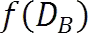
Release the data “anonymously” or release a model?
Server
D_{B}"
Individual 1
r₁"
Individual 2
r₂"
Individual 3
r₃"
Individual N&
r_{N}"

Slide 96
Why Anonymize?
For Data Sharing
Give real(istic) data to others to study without compromising privacy of individuals in the data
Allows third-parties to try new analysis and mining techniques not thought of by the data owner
For Data Retention and Usage
Various requirements prevent companies from retaining customer information indefinitely
E.g. Google progressively anonymizes IP addresses in search logs
Internal sharing across departments (e.g. billing → marketing)

Slide 97
Why Anonymize?

Slide 98
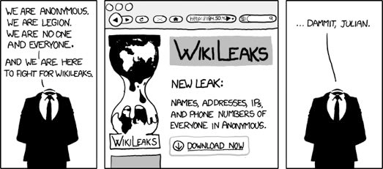
Releasing data is bad?
What if we ensure our names and other identiﬁers are never released?

Slide 99

Case Study: US Census
Raw data: information about every US household
Who, where; age, gender, racial, income and educational data
Why released: determine representation, planning
How anonymized: aggregated to geographic areas (Zip code)
Broken down by various combinations of dimensions
Released in full after 72 years
Attacks: no reports of successful deanonymization
Recent attempts by FBI to access raw data rebuffed
Consequences: greater understanding of US population
Affects representation, funding of civil projects
Rich source of data for future historians and genealogists

Slide 100

Case Study: Netflix Prize
Raw data: 100M dated ratings from 480K users to 18K movies
Why released: improve predicting ratings of unlabeled examples
How anonymized: exact details not described by Netflix
All direct customer information removed
Only subset of full data; dates modified; some ratings deleted,
Movie title and year published in full
Attacks: dataset is claimed vulnerable [Narayanan Shmatikov 08]
Attack links data to IMDB where same users also rated movies
Find matches based on similar ratings or dates in both
Consequences: rich source of user data for researchers
unclear if attacks are a threat—no lawsuits or apologies yet

Slide 101

The Massachusetts Governor Privacy Breach [Sweeney IJUFKS 2002]
Name
SSN
Visit Date
Diagnosis
P rocedure
Medication
T otal Charge
Zip
Birth date
Sex
Medical Data

Slide 102

The Massachusetts Governor Privacy Breach [Sweeney IJUFKS 2002]
Name
S SN
Visit Date
D iagnosis
P rocedure
Medication
T otal Charge
Name
A ddress
Date Registered
P arty aﬃliation
Date last voted
Zip
Birth date
Sex
Medical Data

Slide 103
The Massachusetts Governor Privacy Breach [Sweeney IJUFKS 2002]
Name
SSN
V isit Date
D iagnosis
Procedure
Medication
T otal Charge
Name
A ddress
Date Registered
P arty aﬃliatioon
Date last voted
Governor of MA uniquely identiﬁed using ZipCode, Birth Date, and Sex.
Zip
Birth date
Sex
Name linked to Diagnosis
Medical Data
Voter List

Slide 104

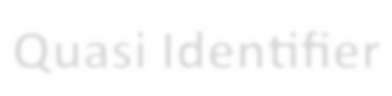
The Massachusetts Governor Privacy Breach [Sweeney IJUFKS 2002]
87 % of US population uniquely identified
Name
SSN
V isit Date
D iagnosis
Procedure
Medication
T otal Charge
Name
A ddress
Date Registered
P arty aﬃliatioon
Date last voted
Governor of MA
Zip
using ZipCode,
Birth Date, and Sex.
Birth date
Sex
Quasi-Identiﬁers
Medical Data
Voter List

Slide 105

AOL data publishing fiasco …
AOL “anonymously” released a list of 21 million web search queries.
Ashwin222 Ashwin222 Ashwin222 Ashwin222 Pankaj156 Pankaj156 Cox12345 Cox12345 Cox12345 Cox12345
Ashwin222
Ashwin222
Uefa cup
Uefa champions league Champions league final Champions league final 2007 exchangeability
Proof of deFinitti s theorem Zombie games
Warcraft
Beatles anthology Ubuntu breeze
Grammy 2008 nominees
Amy Winehouse rehab

Slide 106
AOL data publishing fiasco …
AOL “anonymously” released a list of 21 million web search queries.
UserIDs were replaced by random numbers …
865712345 | Uefa cup
865712345 | Uefa champions league
865712345 | Champions league final
865712345 | Champions league final 2007
236712909 | exchangeability
236712909 | Proof of deFinitti s theorem
112765410 | Zombie games
112765410 | Warcraft
112765410 | Beatles anthology
112765410 | Ubuntu breeze
865712345 | Grammy 2008 nominees
865712345 | Amy Winehouse rehab

Slide 107

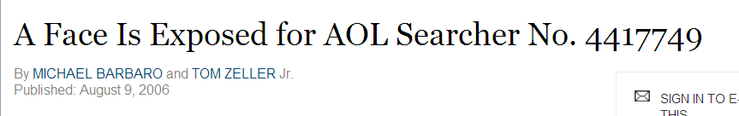
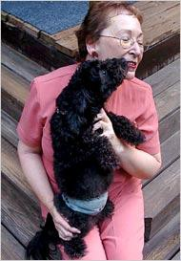
Privacy Breach
[NYTimes 2006]

Slide 108

Case Study: AOL Search Data
Raw data: 20M search queries for 650K users from 2006
Why released: allow researchers to understand search patterns
How anonymized: user identifiers removed
All searches from same user linked by an arbitrary identifier
Attacks: many successful attacks identified individual users
Ego-surfers: people typed in their own names
Zip codes and town names identify an area
NY Times identified 4417749 as 62yr old GA widow [Barbaro Zeller 06]
Consequences: CTO resigned, two researchers fired
Well-intentioned effort failed due to inadequate anonymization

Slide 109


Can we release a model alone?
Release the data “anonymously” or release a model
Server
D_{B}"
Individual 1
r₁"
Individual 2
r₂"
Individual 3
r₃"
Individual N&
r_{N}"

Slide 110

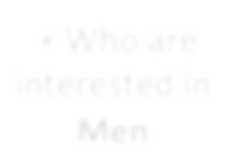


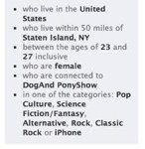

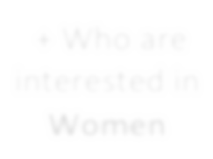
Releasing a model can also be bad
[Korolova JPC 2011]
Number of
Facebook proﬁle
Impressions
25
+ Who are interested in Men
+
Online Data
+ Who are interested in Women
0
Facebook's learning algorithm uses private information to predict match to ad

Slide 111
Model Inversion
[Frederickson et al., USENIX Security 2014]
An attacker, given the model and some demographic information about a patient, can predict the patient's genetic markers.

Slide 112
Models of Anonymization
Interactive Model (akin to statistical databases)
Data owner acts as “gatekeeper” to data
Researchers pose queries in some agreed language
Gatekeeper gives an (anonymized) answer, or refuses to answer
“Send me your code” model
Data owner executes code on their system and reports result
Cannot be sure that the code is not malicious
Offline, aka “publish and be damned” model
Data owner somehow anonymizes data set
Publishes the results to the world, and retires
Our focus in this tutorial – seems to model most real releases

Slide 113
Objectives for Anonymization
Prevent (high confidence) inference of associations
Prevent inference of salary for an individual in “census”
Prevent inference of individual’s viewing history in “video”
Prevent inference of individual’s search history in “search”
All aim to prevent linking sensitive information to an individual
Prevent inference of presence of an individual in the data set
Satisfying “presence” also satisfies “association” (not vice-versa)
Presence in a data set can violate privacy (eg STD clinic patients)
Have to model what knowledge might be known to attacker
Background knowledge: facts about the data set (X has salary Y)
Domain knowledge: broad properties of data (illness Z rare in men)

Slide 114
Utility
Anonymization is meaningless if utility of data not considered
The empty data set has perfect privacy, but no utility
The original data has full utility, but no privacy
What is “utility”? Depends what the application is…
For fixed query set, can look at max, average distortion
Problem for publishing: want to support unknown applications!
Need some way to quantify utility of alternate anonymizations

Slide 115
Privacy is not Anonymity
Bob's record is indistinguishable from records of other Cancer patients
We can infer Bob has Cancer !
“New Information” principle
Privacy is breached if releasing D (or f(D)) allows an adversary to learn
sufficient new information.
New Information = distance(adversary's prior belief, adversary's posterior belief after seeing D)
New Information can't be 0 if the output D or f(D) should be useful.

Slide 116
Privacy Definitions
Many privacy definitions
L-diversity, T-closeness, M-invariance, ε- Differential privacy, E- Privacy, …
Definitions differs in
What information is considered sensitive
Specific attribute (disease) vs all possible properties of an individual
What is the adversary's prior
All values are equally likely vs Adversary knows everything about all but one
individuals
How is new information measured
Information theoretic measures
Pointwise absolute distance
Pointwise relative distance

Slide 117
No Free Lunch
Why can't we have a single definition for privacy?
– For every adversarial prior and every property about an individual, new information is bounded by some constant.
No Free Lunch Theorem: For every algorithm that outputs a D with even a sliver of utility, there is some adversary with a prior such that privacy is not guaranteed.

Slide 118
randomized Response Model
N respondents asked a sensitive “yes/no” question.
Surveyor wants to compute fraction π who answer “yes”.
Respondents don't trust the surveyor.
What should the respondents do?

Slide 119
randomized Response Model
Flip a coin
heads with probability p, and
tails with probability 1-p (p > ½)
Answer question according to the following table:
 | True Answer = Yes | True Answer = No
Heads | Yes | No
Tails | No | Yes

Slide 120
Sample Microdata
SSN | Zip | Age | Nationality | Disease
631-35-1210 | 13053 | 28 | Russian | Heart
051-34-1430 | 13068 | 29 | American | Heart
120-30-1243 | 13068 | 21 | Japanese | Viral
070-97-2432 | 13053 | 23 | American | Viral
238-50-0890 | 14853 | 50 | Indian | Cancer
265-04-1275 | 14853 | 55 | Russian | Heart
574-22-0242 | 14850 | 47 | American | Viral
388-32-1539 | 14850 | 59 | American | Viral
005-24-3424 | 13053 | 31 | American | Cancer
248-223-2956 | 13053 | 37 | Indian | Cancer
221-22-9713 | 13068 | 36 | Japanese | Cancer
615-84-1924 | 13068 | 32 | American | Cancer

Slide 121
Removing SSN …
Zip | Age | Nationality | Disease
13053 | 28 | Russian | Heart
13068 | 29 | American | Heart
13068 | 21 | Japanese | Viral
13053 | 23 | American | Viral
14853 | 50 | Indian | Cancer
14853 | 55 | Russian | Heart
14850 | 47 | American | Viral
14850 | 59 | American | Viral
13053 | 31 | American | Cancer
13053 | 37 | Indian | Cancer
13068 | 36 | Japanese | Cancer
13068 | 32 | American | Cancer

Slide 122
Linkage Attacks
Zip | Age | Nationality | Disease
13053 | 28 | Russian | Heart
13068 | 29 | American | Heart
13068 | 21 | Japanese | Viral
13053 | 23 | American | Viral
14853 | 50 | Indian | Cancer
14853 | 55 | Russian | Heart
14850 | 47 | American | Viral
14850 | 59 | American | Viral
13053 | 31 | American | Cancer
13053 | 37 | Indian | Cancer
13068 | 36 | Japanese | Cancer
13068 | 32 | American | Cancer
Quasi-
Identifier
Public Information

Slide 123
K-Anonymity
[Samarati et al, PODS 1998]
Generalize, modify, or distort quasi-identifier values so that no
individual is uniquely identifiable from a group of k
In SQL, table T is k-anonymous if each
SELECT COUNT(*) FROM T
GROUP BY Quasi-Identifier
is ≥ k
Parameter k indicates the “degree” of anonymity

Slide 124


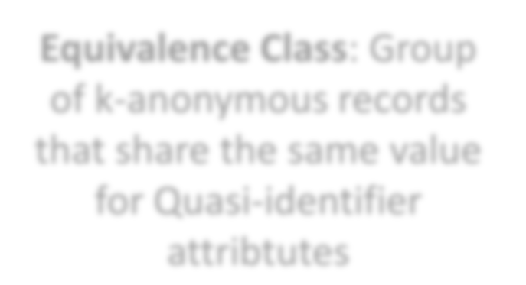
Example: Generalization (Coarsening)
 |  |  | Disease
13053 | 28 | Russian | Heart
13068 | 29 | American | Heart
13068 | 21 | Japanese | Flu
13053 | 23 | American | Flu
14853 | 50 | Indian | Cancer
14853 | 55 | Russian | Heart
14850 | 47 | American | Flu
14850 | 59 | American | Flu
13053 | 31 | American | Cancer
Zip | Age | Nationality | Disease
130** | <30 | * | Heart
130** | <30 | * | Heart
130** | <30 | * | Flu
130** | <30 | * | Flu
1485* | >40 | * | Cancer
1485* | >40 | * | Heart
1485* | >40 | * | Flu
1485* | >40 | * | Flu
130** | 30-40 | * | Cancer
130** | 30-40 | * | Cancer
130** | 30-40 | * | Cancer
130** | 30-40 | * | Cancer
Zip Age Nationality
Eq₃₇uivalenc_{I}e_{nd}C_{ia}l_{n}ass: Gro_{Ca}u_{n}p_{cer}
13053
of k-anonymous records
13068
36 Japanese Cancer
that share the same value
13068
32 American
Cancer
for Quasi-identifier
attribtutes

Slide 125
K-anonymity through Microaggregation
 |  |  | Disease
13053 | 28 | Russian | Heart
13068 | 29 | American | Heart
13068 | 21 | Japanese | Flu
13053 | 23 | American | Flu
14853 | 50 | Indian | Cancer
14853 | 55 | Russian | Heart
14850 | 47 | American | Flu
14850 | 59 | American | Flu
13053 | 31 | American | Cancer
13053 | 37 | Indian | Cancer
13068 | 36 | Japanese | Cancer
13068 | 32 | American | Cancer
Zip Age Nationality
Zip | Age | Nationality | Disease
4 tuples Zip code = 130** 23 < Age < 29 |  |  | 2 Heart and 2 Flu
Average(age) = 25
4 tuples |  |  | 1 Cancer,
Zip = 1485* 47 < Age < 59 |  |  | 1 Heart and
Average(age) = 53 |  |  | 2 Flu
4 tuples Zip = 130** 31 < Age < 37 |  |  | All Cancer patients
Avergae(age) = 34

Slide 126

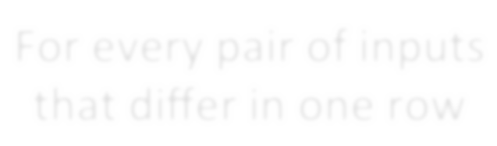



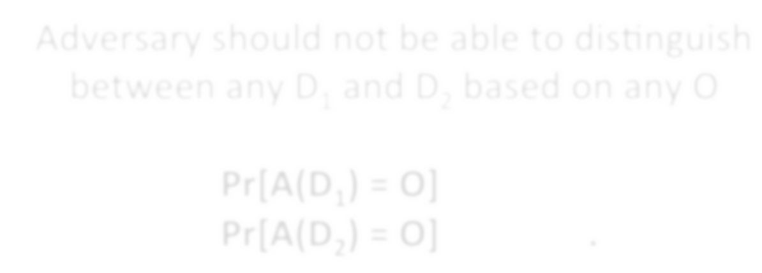
DiFFerential Privacy
[Dwork ICALP 2006]
For every pair of inputs that diﬀer in one row
For every output …
^{D}1 ^{D}2
O
Adversary should not be able to distinguish between any D₁ and D₂ based on any O

Slide 127
DiFFerential Privacy
Typically achieved by adding controlled noise (e.g., Laplace Mechanism)
Some adoption in the wild:
US Census Bureau
Google, Apple, and some others have used this for collecting data
Issues:
Effectiveness in general still unclear

Slide 128
Outline
Informed Consent
Reproducibility
p-value Hacking
Who owns the data?
Privacy & Anonymity
Debugging Data Science
Algorithmic fairness
Other Issues
Data Science in Industry

Slide 145
The dream
You run your ML algorithm(s) and it works well (?!)
Still: be skeptical …
Very easy to accidentally let your ML algorithm cheat:
Peaking (train/test bleedover)
Including output as an input feature explicitly
Including output as an input feature implicitly
Try to solve the problem by hand;
Try to interpret the ML algorithm / output
Continue being skeptical. Always be skeptical.

Slide 146
Outline
Informed Consent
Reproducibility
p-value Hacking
Who owns the data?
Privacy & Anonymity
Algorithmic fairness
Data validity/provenance

Slide 147
Data Science Lifecycle: An Alternate View

Slide 148
Combating bias
Fairness through blindness:
Don’t let an algorithm look at protected attributes
Examples currently in use ??????????
Race
Gender
Sexuality
Disability
Religion
Problems with this approach ?????????

Slide 149
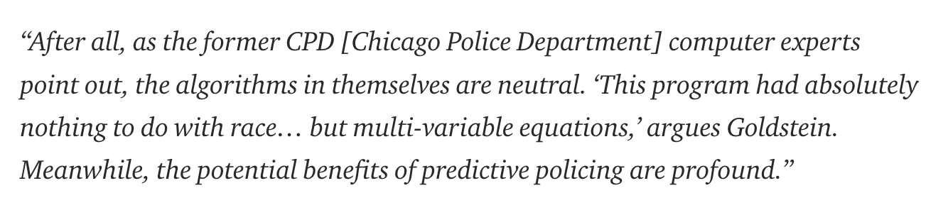
Combating bias

Slide 150
Combating bias
If there is bias in the training data, the algorithm/ML technique will pick it up
Especially social biases against minorities
Even if the the protected attributes are not used
Sample sizes tend to vary drastically across groups
Models for the groups with less representation are less accurate
Hard to correct this, and so fundamentally unfair
e.g., a classifier that performs no better than coin toss on a minority group, but does very well on a majority group

Slide 151
Combating bias
Cultural Differences
Consider a social network that tried to classify user names into real and fake
Diversity in names differs a lot – in some cases, short common names are ‘real’, in others long unique names are ‘real’

Slide 152
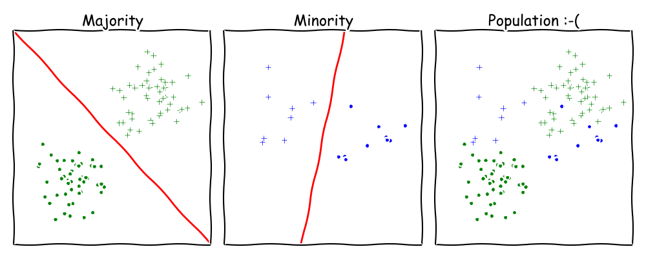
Combating bias
Undesired complexity
Learning combinations of linear classifiers much harder than learning linear classifiers

Slide 153
Combating Bias
Demographic parity:
A decision must be independent of the protected attribute
E.g., a loan application’s acceptance rate is independent of an applicant’s race (but can be depenedent on non-protected features like salary)
Formally: binary decision variable C, protected attribute A
P{ C = 1 | A = 0 } = P{ C = 1 | A = 1 }
Membership in a protected class should have no correlation with the final decision.
Problems ????????
Example from Moritz Hardt’s blog

Slide 154
Combating Bias
What if the decision isn’t the thing that matters?
“Consider, for example, a luxury hotel chain that renders a promotion to a subset of wealthy whites (who are likely to visit the hotel) and a subset of less affluent blacks (who are unlikely to visit the hotel). The situation is obviously quite icky, but demographic parity is completely fine with it so long as the same fraction of people in each group see the promotion.”
Demographic parity allows classifiers that select qualified candidates in the “majority” demographic and unqualified candidate in the “minority” demographic, within a protected attribute, so long as the expected percentages work out.
More: http://blog.mrtz.org/2016/09/06/approaching-fairness.html
Example from Moritz Hardt’s blog

Slide 155

FATML
This stuff is really tricky (and really important).
It’s also not solved, even remotely, yet!
New community: Fairness, Accountability, and Transparency in Machine Learning (aka FATML)
“… policymakers, regulators, and advocates have expressed fears about the potentially discriminatory impact of machine learning, with many calling for further technical research into the dangers of inadvertently encoding bias into automated decisions.”

Slide 156
F is for Fairness
In large data sets, there is always proportionally less data available about minorities.
Statistical patterns that hold for the majority may be invalid for a given minority group.
Fairness can be viewed as a measure of diversity in the combinatorial space of sensitive attributes, as opposed to the geometric space of features.
Thanks to: Faez Ahmed

Slide 157
A is for accountability
Accountability of a mechanism implies an obligation to report, explain, or justify algorithmic decision-making as well as mitigate any negative social impacts or potential harms.
Current accountability tools were developed to oversee human decision makers
They often fail when applied to algorithms and mechanisms instead
Example, no established methods exist to judge the intent of a piece of software. Because automated decision systems can return potentially incorrect, unjustified or unfair results, additional approaches are needed to make such systems accountable and governable.
Thanks to: Faez Ahmed

Slide 158
T is for transparency
Automated ML-based algorithms make many important decisions in life.
Decision-making process is opaque, hard to audit
A transparent mechanism should be:
understandable;
more meaningful;
more accessible; and
more measurable.
Thanks to: Faez Ahmed

Slide 159
Data collection
What data should (not) be collected
Who owns the data
Whose data can (not) be shared
What technology for collecting, storing, managing data
Whose data can (not) be traded
What data can (not) be merged
What to do with prejudicial data
Thanks to: Kaiser Fung

Slide 160
Data Modeling
Data is biased (known/unknown)
Invalid assumptions
Confirmation bias
Publication bias
WSDM 2017: https://arxiv.org/abs/1702.00502
Badly handling missing values
Thanks to: Kaiser Fung

Slide 161
Deployment
Spurious correlation / over-generalization
Using “black-box” methods that cannot be explained
Using heuristics that are not well understood
Releasing untested code
Extrapolating
Not measuring lifecycle performance (concept drift in ML)
We will go over ways to counter this in the ML/stats/hypothesis testing portion of the course
Thanks to: Kaiser Fung

Slide 162
Guiding principles
Start with clear user need and public benefit
Use data and tools which have minimum intrusion necessary
Create robust data science models
Be alert to public perceptions
Be as open and accountable as possible
Keep data secure
Thanks to: UK cabinet office

Slide 163
Some references
Presentation on ethics and data analysis, Kaiser Fung @ Columbia Univ. http://andrewgelman.com/wp-content/uploads/2016/04/fung_ethics_v3.pdf
O’Neil, Weapons of math destruction. https://www.amazon.com/Weapons-Math-Destruction-Increases-Inequality/dp/0553418815
UK Cabinet Office, Data Science Ethical Framework. https://www.gov.uk/government/publications/data-science-ethical-framework
Derman, Modelers’ Hippocratic Oath. http://www.iijournals.com/doi/pdfplus/10.3905/jod.2012.20.1.035
Nick D’s MIT Tech Review Article. https://www.technologyreview.com/s/602933/how-to-hold-algorithms-accountable/

Slide 164
Outline
Informed Consent
Reproducibility
p-value Hacking
Who owns the data?
Privacy & Anonymity
Algorithmic fairness
Some other issues
Data Science in Industry

Slide 165
data validity/Provenance
Provenance: a history of how a data item or a dataset came to be
Also called lineage
Crucial to reason about the validity of any results, or to do auditing
Lot of research over the years
File system/OS-level provenance, data provenance, workflow provenance
Increasing interest in industry, but pretty nascent field

Slide 166
Interpretability/Explainability
Can you explain the results of an ML model?
Easy for decision trees (relatively), nearly impossible for deep learning
Can’t use black box models in many domains
e.g., health care, policy-making
Several recent proposals on simpler models, but those tend to have high error rates
Other proposals on trying to interprete more complex models
Evolving area…
Big DARPA project: Explainable AI

Slide 167
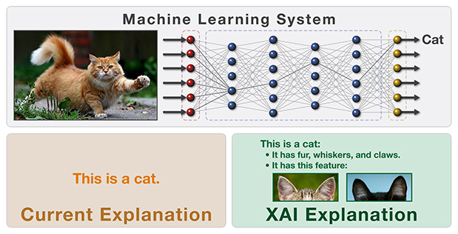
Interpretability/Explainability
From https://www.darpa.mil/program/explainable-artificial-intelligence

Slide 168
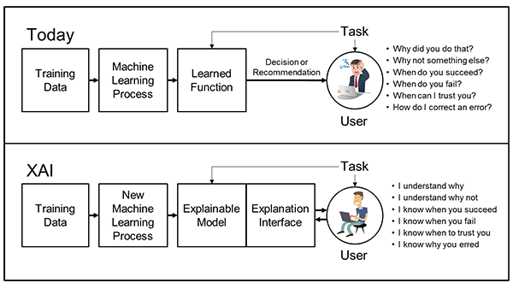
Interpretability/Explainability
From https://www.darpa.mil/program/explainable-artificial-intelligence

Slide 169
Outline
Informed Consent
Reproducibility
p-value Hacking
Who owns the data?
Privacy & Anonymity
Algorithmic fairness
Some other issues
Data Science in Industry

Slide 170
What is a data scientist?
Many types of “data scientists” in industry …
Business analysts, renamed
“… someone who analyzes an organization or business domain (real or hypothetical) and documents its business or processes or systems, assessing the business model or its integration with technology.” – Wikipedia
Statisticians
Machine learning engineer
Backend tools developer
Thanks to: Zico Kolter

Slide 171
Key differences
Classical statistics vs machine learning approaches
(Two are nearly mixed in most job calls you will see.)
Developing data science tools vs. doing data analysis
Working on a core business product vs more nebulous “identification of value” for the firm

Slide 172
Finding a job
Make a personal website.
Free hosting options: GitHub Pages, Google Sites
Pay for your own URL (but not the hosting).
Make a clean website, and make sure it renders on mobile:
Bootstrap: https://getbootstrap.com/
Foundation: http://foundation.zurb.com/
Highlight relevant coursework, open source projects, tangible work experience, etc
Highlight tools that you know (not just programming languages, but also frameworks like TensorFlow and general tech skills)

Slide 173
“Requirements”
Data science job postings – and, honestly, CS postings in general – often have completely nonsense requirements
The group is filtering out some noise from the applicant pool
Somebody wrote the posting and went buzzword crazy
In most cases (unless the position is a team lead, pure R&D, or a very senior role) you can work around requirements:
A good, simple website with good, clean projects can work wonders here …
Reach out and speak directly with team members
Alumni network, internship network, online forums

Slide 174
Interviewing
We saw that there is no standard for being a “data scientist” – and there is also no standard interview style …
… but, generally, you’ll be asked about the five “chunks” we covered in this class, plus core CS stuff:
Software engineering questions
Data collection and management questions (SQL, APIs, scraping, newer DB stuff like NoSQL, Graph DBs, etc)
General “how would you approach …” EDA questions
Machine learning questions (“general” best practices, but you should be able to describe DTs, RFs, SVM, basic neural nets, KNN, OLS, boosting, PCA, feature selection, clustering)
Basic “best practices” for statistics, e.g., hypothesis testing
Take-home data analysis project (YMMV)

Slide 175
Graduate school, Academia, R&D, …
Data science isn’t really an academic discipline by itself, but it comes up everywhere within and without CS
Modern science is built on a “CS and Statistics stack” …
Academic work in the area:
Outside of CS, using techniques from this class to help fundamental research in that field
Within CS, fundamental research in:
Machine learning
Statistics (non-pure theory)
Databases and data management
Incentives, game theory, mechanism design
Within CS, trying to automate data science (e.g., Google Cloud’s Predictive Analytics, “Automatic Statistician,” …)

Slide 176
Conclusions
Final project due in 2 weeks
Will send out a survey in a few days – please complete it
Sign up for remaining courses
Converting to MS

